Slide 1

ML23/24-09 Approve Prediction of Multisequence Learning
Gaurav Kale(1427213)

Slide 2
Understanding Multisequence Learning: Multisequence Learning involves training models on datasets that contain multiple sequences of data. This could be in various domains such as time series analysis, natural language processing, genomics, etc.
Reading Dataset from Saved File: need to load your dataset from a saved file. This dataset would contain multiple sequences, each representing a series of data points. Depending on the format of data, might use libraries like pandas in Python, C# to read the data into a suitable data structure.
Reading Test Dataset from Saved File: Similar to reading the main dataset, also load your test dataset from a saved file. This test dataset typically consists of subsequences extracted from the main dataset, which you'll use to evaluate your model's performance.

Slide 3
Calculating Accuracy of Predicted Element: After training your Multisequence Learning model, use it to make predictions on the test dataset. Then, compare these predictions with the actual values to calculate the accuracy. Depending on your task, accuracy might be calculated differently. For instance, in sequence prediction tasks, you might use metrics like sequence accuracy, F1-score, or others
Creating Synthetic Dataset - : This step involves generating a synthetic dataset where the data points are generated synthetically, possibly through a defined process such as addition. For instance, you might generate sequences of numbers where each element is the sum of the previous elements, creating a dataset suitable for addition-related tasks.

Slide 4

Execution
FetchHTMConfig()
getEncoder()
ReadDataset()
CreateDataset()
SaveDataset()

Slide 5
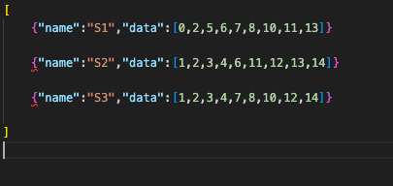
Implementation: Synthetic Dataset

Slide 6
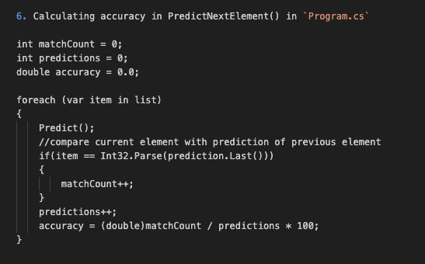
Calculating Accuracy

Slide 7
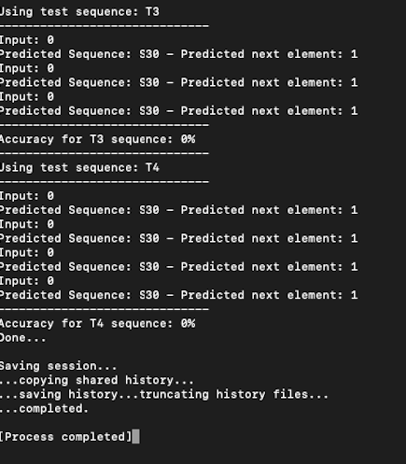
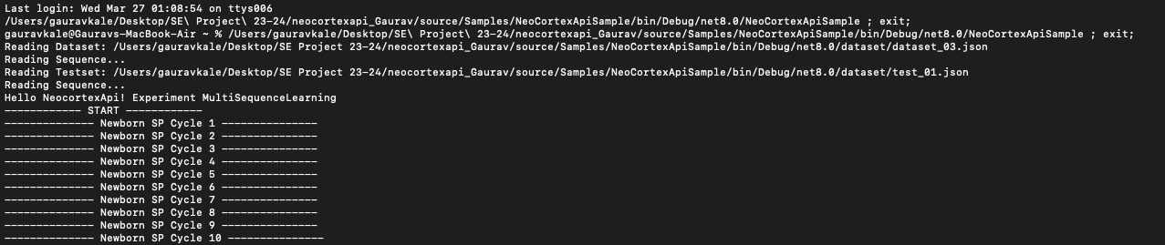
Output AND Result

Slide 8
Closure
Generate test data from a synthetic dataset.
Utilize a configuration file to customize the parameters of the synthetic dataset.

Slide 9

THANK YOU

